Slide 1
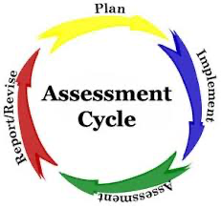
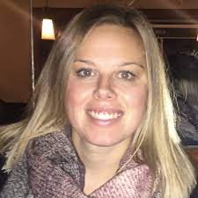
Collate the data from the DART assessment
Identify one reading skill to focus on
Develop class profiles so that individual teams can consider the assessment to instruction cycle
Continue in-class support from our Teacher-Consultant, Briana Adams
Build in Lunch & Learns of lesson sequences that will support our reading focus
Our District’s
What are our next steps?

