Slide 1
DART Results
Looking Closer at Reading Data for Student Learning
and Considering Next Steps for 2025-2026.

Slide 2
WHAT? HOW? WHY?
WHAT?
We did a school-wide reading assessment using the DART tool to see where our students are at with their reading
We chose targeted reading areas based on the baseline results
HOW?
We compared November 2024 DART data (baseline data) to May 2025 DART data by grade groupings and identified targeted reading areas
WHY?
To see if our learners would progress in the identified targeted reading areas with further reading instruction

Slide 3
GRADE 6/7 Targeted Reading Area: Questioning
November 2024
May 2025

Slide 4
GRADE 5/6 Targeted Reading Area: Summarizing
November 2024
May 2025

Slide 5
GRADE 4/5 Targeted Reading Area: Making Connections
November 2024
May 2025

Slide 6
GRADE ¾ Targeted Reading Area: Questioning
November 2024
May 2025

Slide 7
GRADE 2/3 Targeted Reading Area: Questioning
November 2024
May 2025

Slide 8
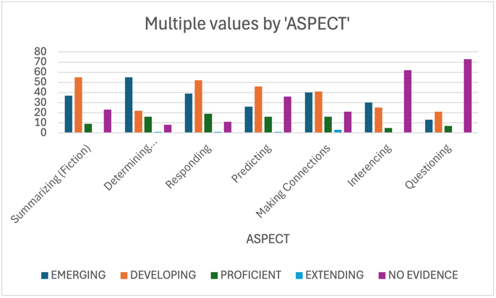
GRADE 1 and ½ Targeted Reading Area: Determining Importance
November 2024
May 2025

Slide 9
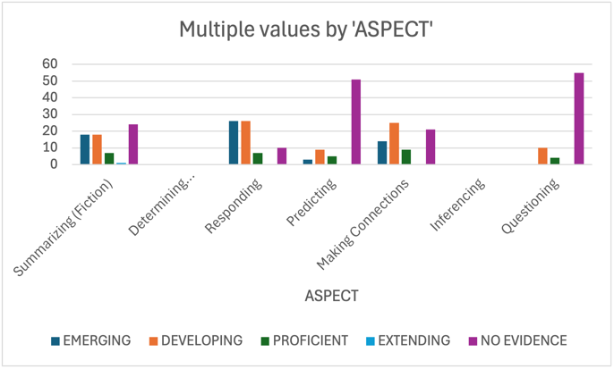
GRADE Kindergarten Targeted Reading Area: Questioning
November 2024
May 2025

Slide 10
What We Noticed…
Grade Group | Targeted Reading Area | Progress
6/7 | Questioning | Significant growth
5/6 | Summarizing | Moderate growth
4/5 | Making Connections | Minimal growth
3/4 | Questioning | Moderate growth
2/3 | Questioning | Moderate growth
1 and 1/2 | Determining Importance | Significant growth
K | Questioning | Minimal growth

